Slide 1


Name: Muhammad Danyal
Reg.No: 4304-BSSE-F21-B
Name: Furqan Ahmad Yousafzai
Reg.No: 4334-BSSE-F21-B
Name: Khalid Khan
Reg.No: 4362-BSSE-F21-B
Name: Nabeel Ahmad
Reg.No: 4315-BSSE-F21-B
Name: Abid Hakimi
Reg.No: 4363-BSSE-F21-B
Submitted To: Sir Shakir Rasheed Khan Khatttak
Presentation

Slide 2
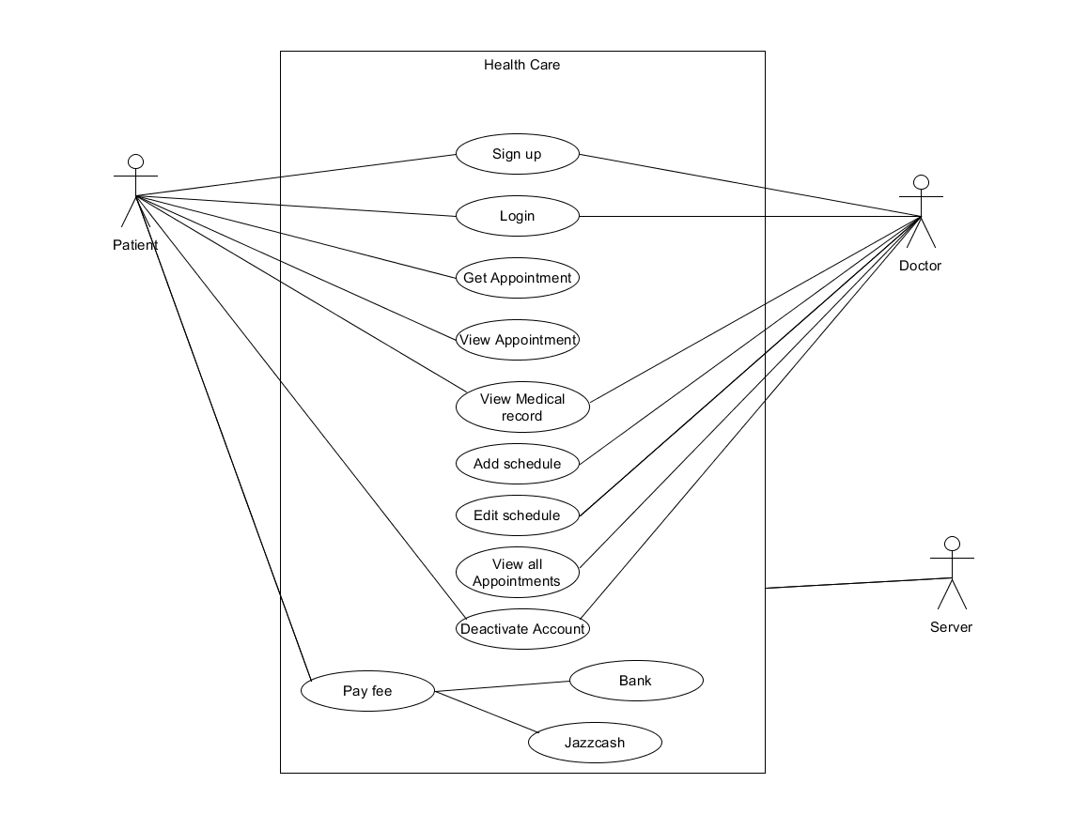
Use case of Doctor Appointment System (Health care):

Slide 3
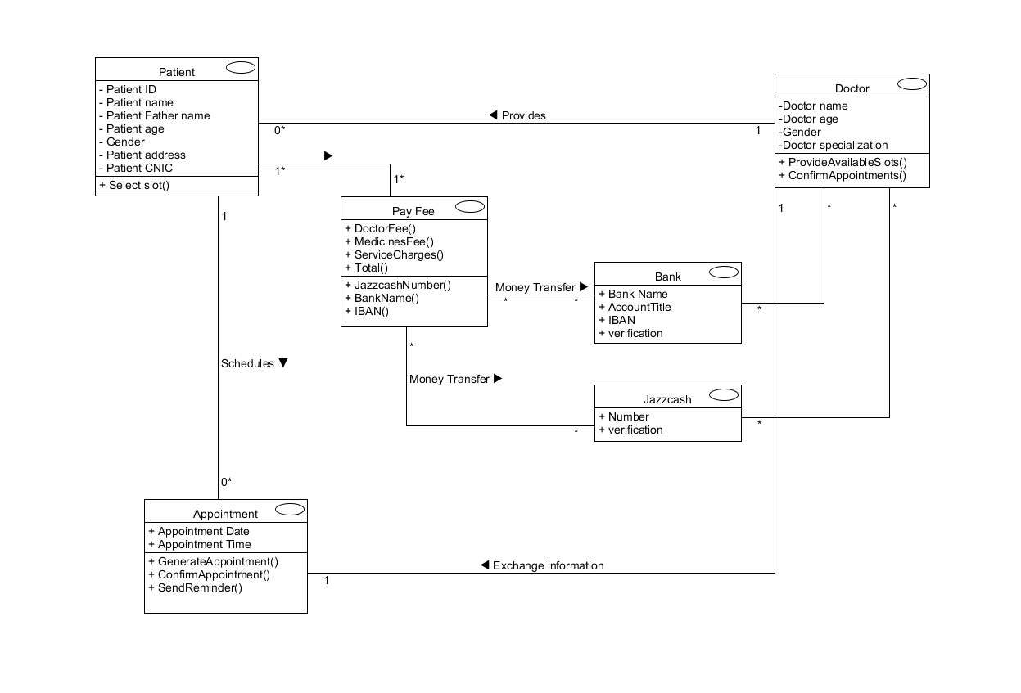
Domain Model of Health Care :

